Slide 1
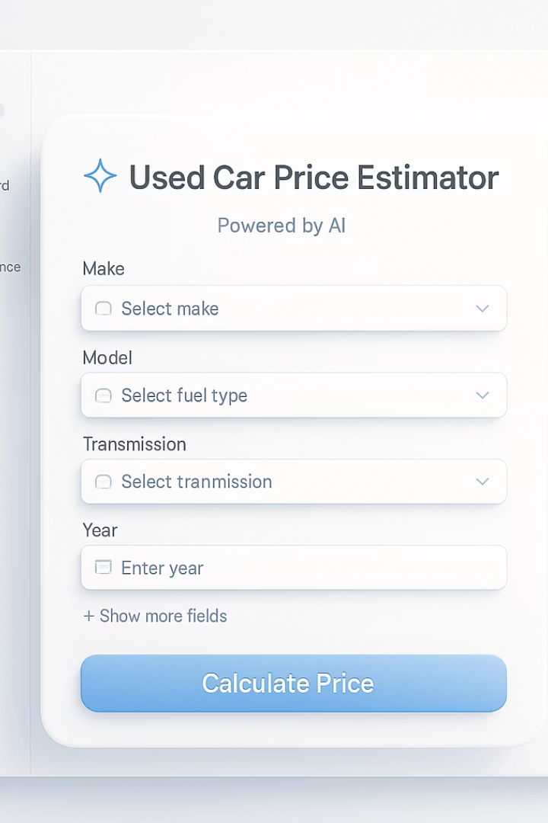

Predicting Used Car Prices with ML
A strategic approach to revolutionising trade-in valuations through machine learning
by Yuri Braga

Slide 2
Project Overview
Predictive tool for trade-in valuations
Stacked ML Ensemble
Instant pricing decisions in under 5 seconds
RF + HGBR + RidgeCV with 76.5% accuracy
FastAPI + Streamlit Solution
Significant Business Impact
Developed through 11 Agile Scrum sprints
+€400k/month for 200-car dealership

Slide 3
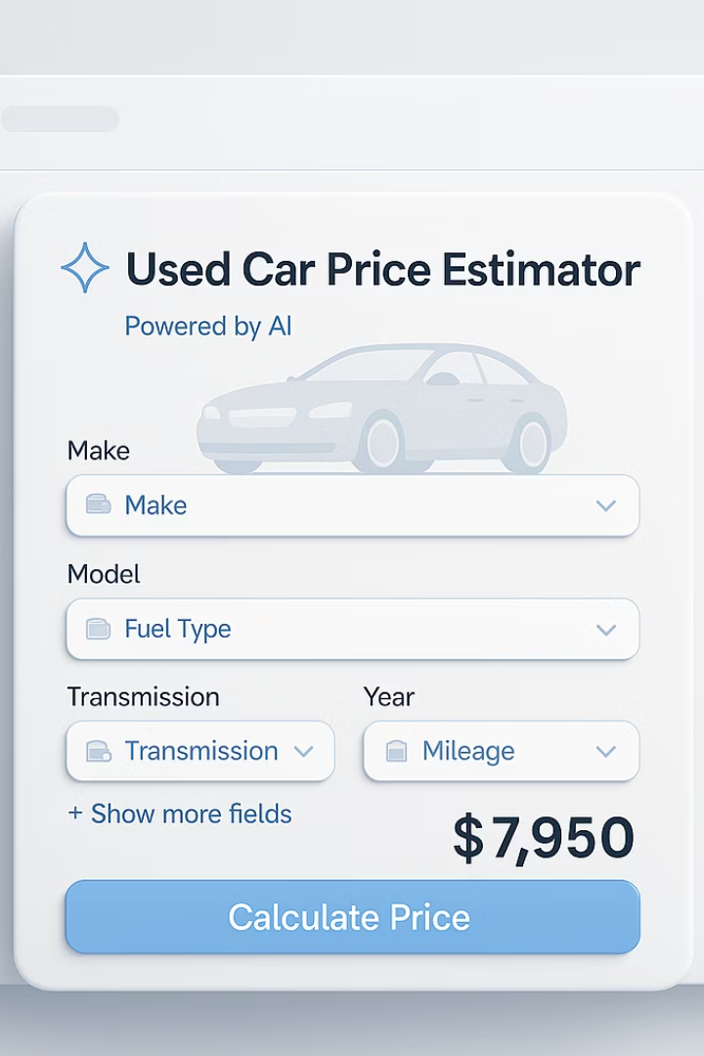




Strategic Problem & Goals
Manual pricing is slow and inconsistent
Current process lacks standardization
Promote sustainability
Extends car lifespans through accurate valuation
Market transparency
Data-driven appraisals build trust
Increased profitability
Maximize returns in growing market (+10% CAGR)

Slide 4
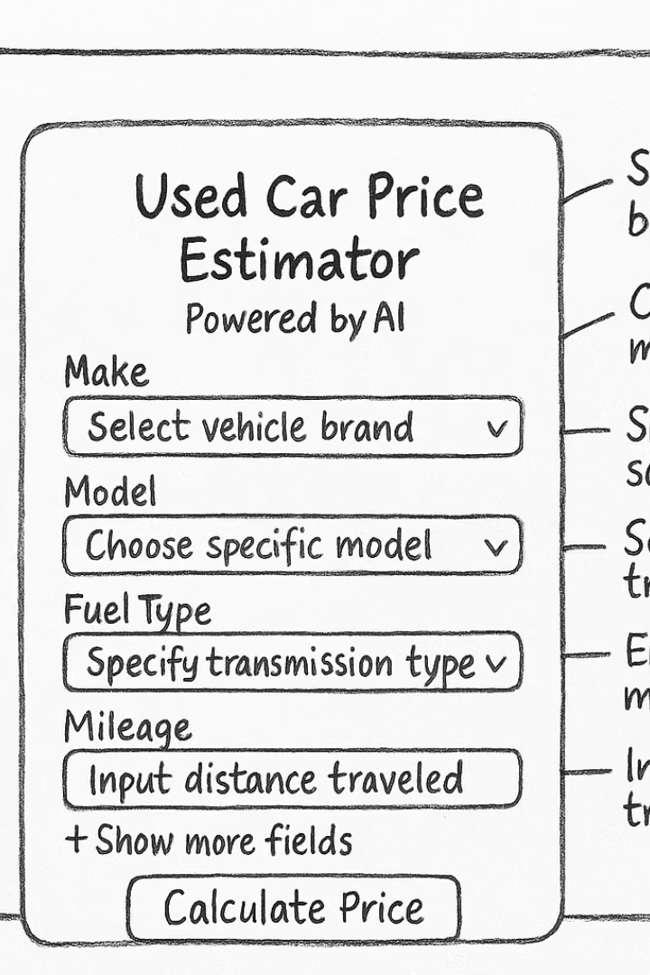



Project Plan - Agile Scrum
Sprints 1-5
Data pipeline & modeling
Sprints 6-8
Backend + UI development
Sprints 9-11
Deployment + testing
Tools: Notion (Kanban), GitHub, FastAPI, Streamlit

Slide 5
Business Understanding
Accurate Pricing
Instant Appraisals
Integration-Ready
Builds trust + increases conversion
Under 5 seconds per vehicle
CRM/SaaS compatible
Eliminates wait time
Scalable architecture
Data-driven decisions

Slide 6








SWOT Analysis
Strengths
Weaknesses
High-accuracy stack model, API-ready
20k sample limits edge-case generalization
Threats
Opportunities
Strong competition, evolving AI regulations
White-label SaaS tool, CRM integration

Slide 7








Methodology
Business Understanding
Data Preparation
Defining dealership needs
Feature engineering + cleaning
Deployment
Modeling
FastAPI + Streamlit implementation
Stacked ensemble approach

Slide 8
Data understanding
Overview
Key Attributes Selected
Source: Public repository on Gigasheet
Manufacturer (brand)
Volume: Over 450,000 used vehicle listings
Model
Sampling: A representative 20,000-row sample used for modeling
Fuel Type (e.g., petrol, diesel, electric)
Transmission (manual, automatic)
Year (of manufacture)
Odometer (mileage)
Price (target variable)

Slide 9
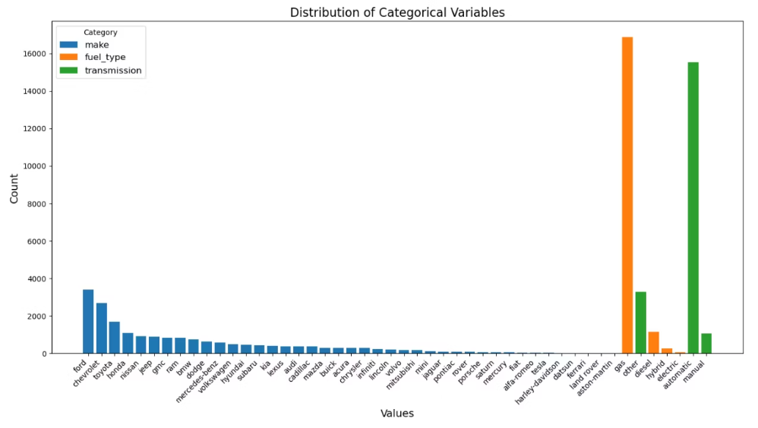
Descriptive Statistics
Distribution of categorical features
High dominance of brands like Ford, Chevrolet, and Toyota.
Class imbalance in fuel types and transmission.

Slide 10
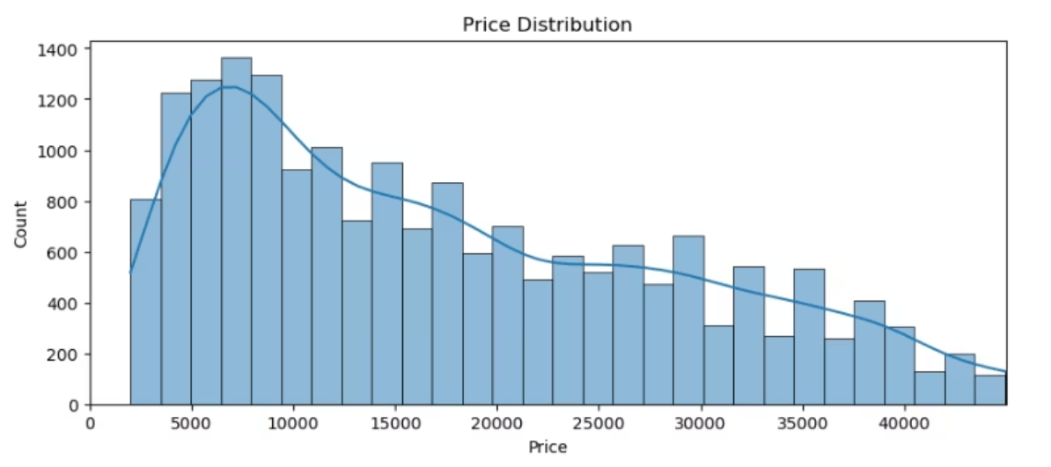
Price Distribution
Distribution of vehicle prices showing right-skewed trend, highlighting need for log transformation during modeling.

Slide 11
Data Exploration (EDA)
Price Distribution
Key Correlations
Feature Engineering
Right-skewed, removed outliers below €1000
Age (-0.62), mileage (-0.58) strongly affect price
Age, mileage/year, luxury brand flag

Slide 12
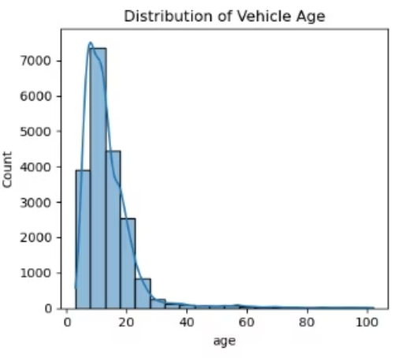
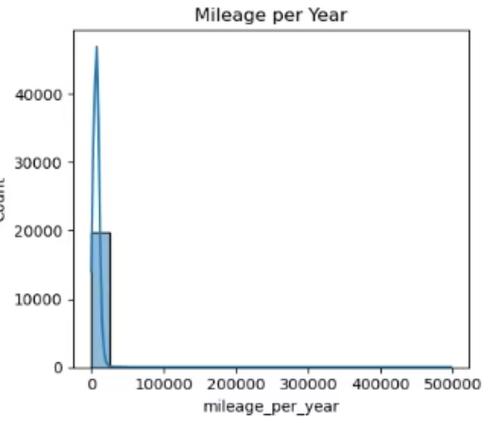
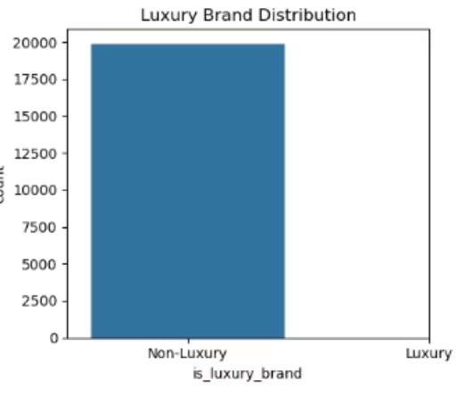
Exploratory Data Analysis: Key Feature Distributions

Slide 13
Engineered Features Overview
Vehicle Age (age)
Calculated from the difference between the current year and the vehicle's manufacturing year.
Captures depreciation effect — older cars tend to be cheaper.
Mileage per Year (mileage_per_year)
Derived by dividing total mileage by vehicle age.
Highlights vehicle usage intensity — useful for understanding wear and predicting maintenance needs.
Luxury Brand (is_luxury_brand)
Binary feature indicating whether the brand is classified as luxury.
Helps capture brand-driven pricing dynamics.

Slide 14
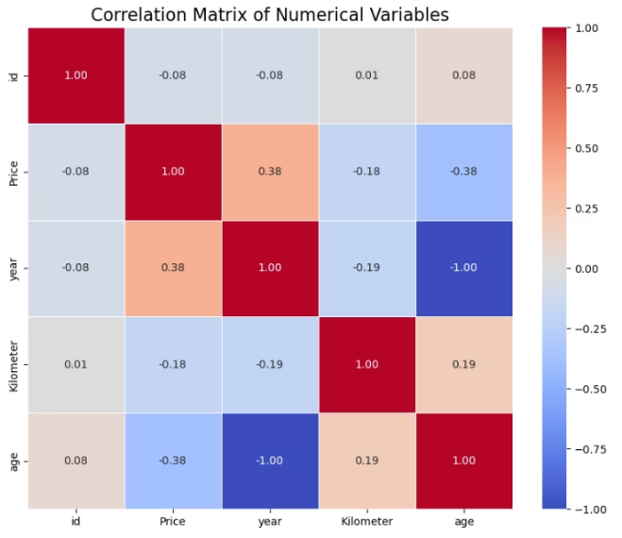
Correlation Matrix
Year vs Age (-1.00): Perfect negative correlation — newer cars are younger.
Age vs Price (-0.38): Older vehicles tend to have lower prices.
Year vs Price (0.38): Newer cars generally cost more.
Kilometre vs Price (-0.18): Slight negative correlation — higher mileage slightly reduces price.

Slide 15
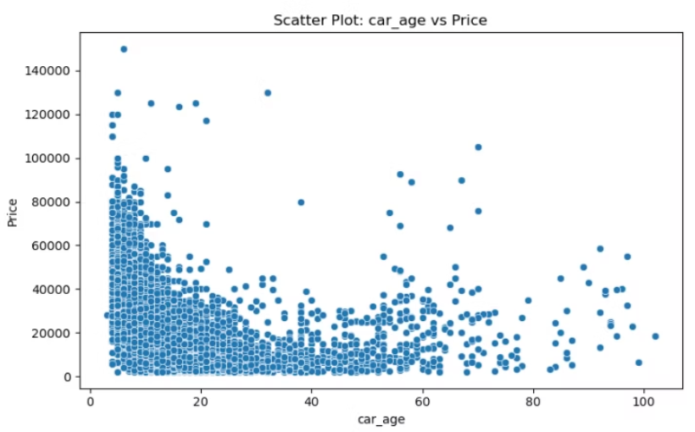
Scatter Plot: Car Age vs Price
Clear downward trend: As car age increases, price generally drops.
Steep decline in early years: New cars lose value quickly.
Price stabilizes: After ~20 years, prices flatten with some scattered outliers (e.g., collectibles or niche models).
Outliers: Some very old or young cars are priced unusually high — possibly luxury or classic cars.

Slide 16



Model Training
Random Forest
Robust baseline model
Histogram Gradient Boosting
Efficient, high accuracy
RidgeCV Meta-Learner
R²: 0.765, RMSE: 0.38

Slide 17
Cross-validation Use
3-fold CV in hyperparameter tuning
5-fold CV used for out-of-fold predictions in Stacking Ensemble
Model
Hyperparameter Tuning
Cross-Validation
Random Forest
✅ Yes
3-fold
Ensures generalisation and prevents overfitting
HistGradientBoost
✅ Yes
3-fold
Stacked Ensemble
✅ (RidgeCV)
5-fold (oof)

Slide 18
Hyperparameter Tuning
Tuning Strategy
Parameter Ranges
RandomizedSearchCV used for:
Random Forest
Random Forest
n_estimators: 150–500
Histogram-based Gradient Boosting
max_depth: None or 10–25
Efficient exploration of parameter space with 10 iterations, 3-fold CV
min_samples_split: 2–10
min_samples_leaf: 1–5
Chosen over GridSearchCV to reduce computational cost on 20K sample
Gradient Boosting
learning_rate: 0.01–0.2
max_iter: 150–600
max_depth: 4–10

Slide 19
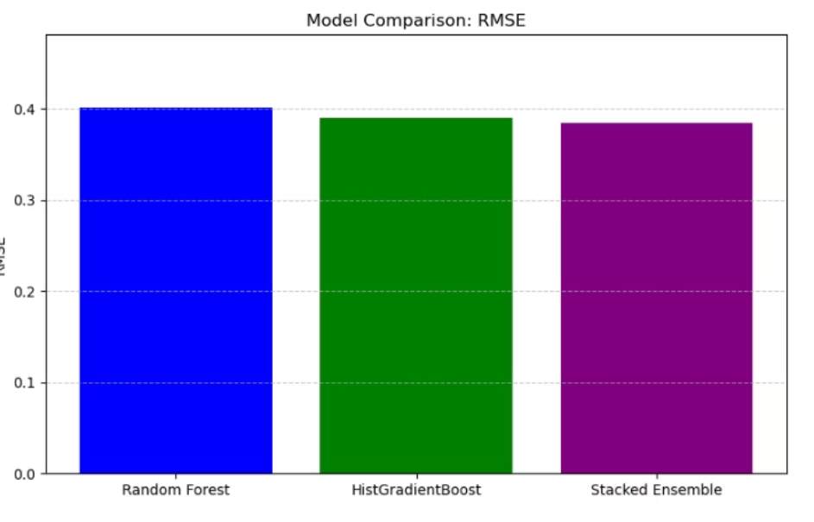
Model Comparison - RMSE
Machine Learning Models Evaluated
RMSE Results
Random Forest: 0.401
Histogram-based Gradient Boosting: 0.390
Stacked Ensemble: 0.385
Key Takeaways
Lower RMSE indicates better prediction accuracy.
The Stacked Ensemble performed best, making it the final model selected.
Ensemble learning helped combine strengths of both individual models.
Random Forest Regressor
Histogram-based Gradient Boosting Regressor
Stacked Ensemble Regressor (Random Forest + Gradient Boosting with RidgeCV)

Slide 20
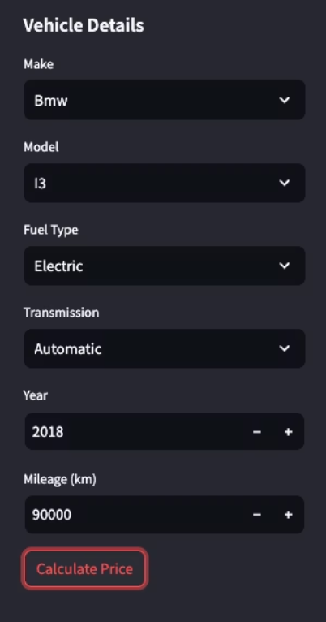
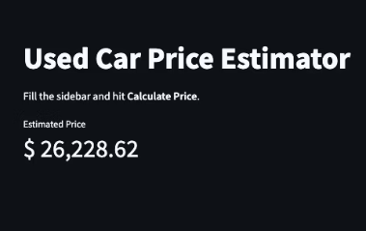
Artefact - Used Car Price Estimator
How It Works:
Select vehicle details in the sidebar: make, model, fuel type, transmission, year, mileage
Dynamic filtering: each dropdown (make → model → fuel type → transmission) updates its options based on your previous selections and the original dataset
Click Calculate Price to send inputs to the AI model
Model predicts log-price and converts it back to an actual price
Estimated price is displayed prominently on the main panel
Inputs and model are cached for a fast, interactive experience

Slide 21
Live vs. Predicted Price Comparison
Case
Vehicle
Predicted Price
Actual Price
Error (%)
1
Altima
$16,503.01
$16,634.00
0.8%
2
2018 BMW i3
$17,709.94
$16,995.00
4.2%
3
2017 Hyundai Tucson Eco
$11,559.95
$13,391.00
13.7%
Range of error: 0.8% (best) → 13.7% (worst)
Average error: ~6.2%kee
Key takeaway: In real-world listings, the tool hits within ±10% of market price most of the time—proof of concept for live trade-in scenarios.

Slide 22
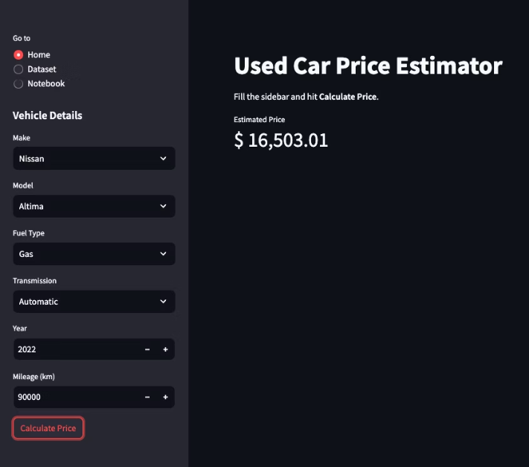
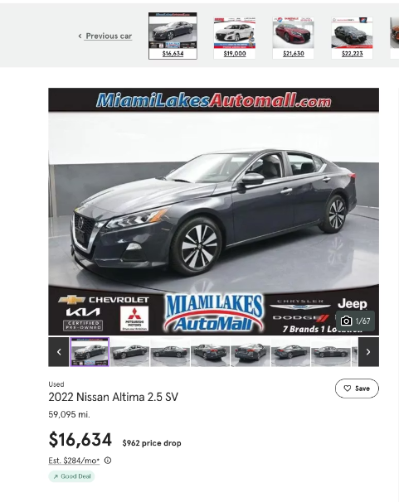
Prediction Accuracy: 99.2% of Actual Price (0.8% Error)

Slide 23
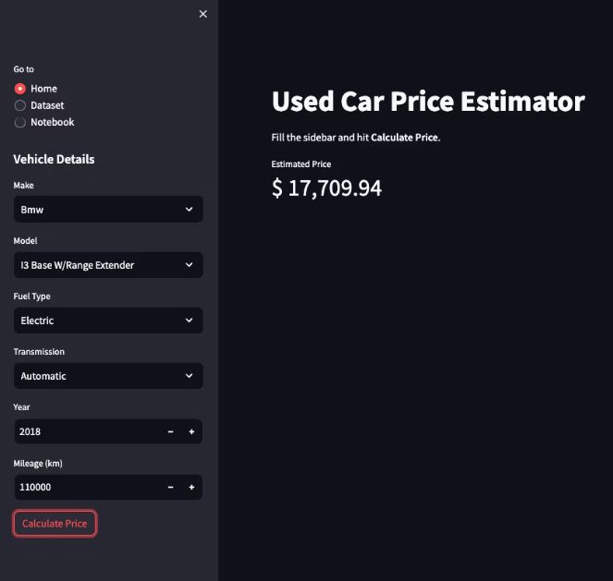
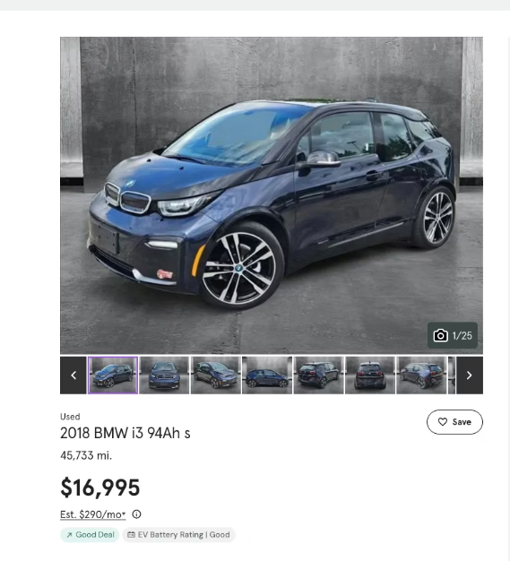
Prediction Accuracy: 95.79% of Actual Price (4.2% Error)

Slide 24
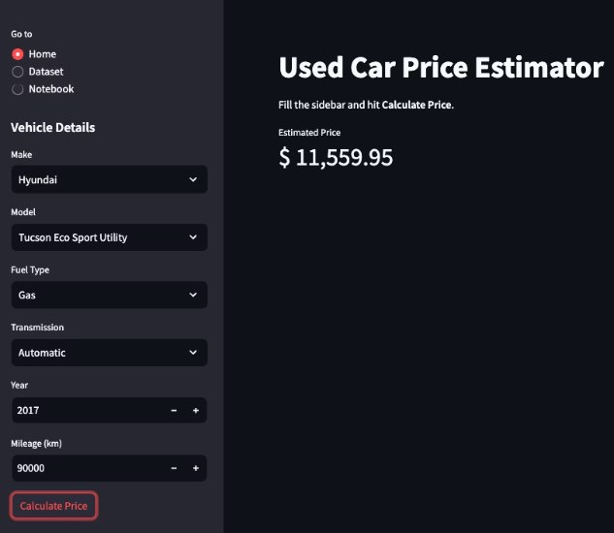
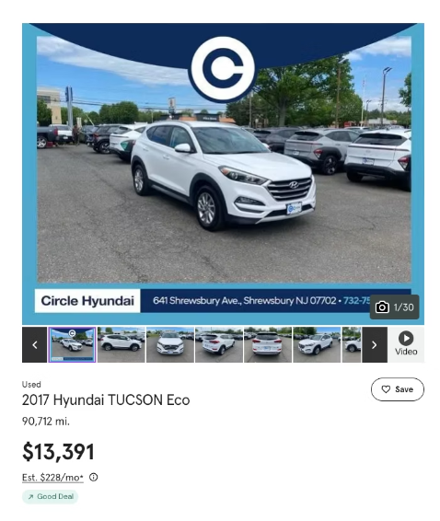
Prediction Accuracy: 86.3% of Actual Price (13.7% Error)

Slide 25





Deployment Architecture
ML Model
Serialized with joblib
FastAPI Backend
/predict endpoint serving results
Streamlit Frontend
User-friendly interface
Cloud Deployment
Scalable infrastructure

Slide 26
Results & Business Impact
<5sec
+20%
Appraisal Time
Conversion Rate
Down from 15 minutes
More completed sales
+40
€400K
Extra Deals
Monthly Profit
Additional monthly transactions
For 200-car dealership

Slide 27
Challenges
Streamlit vs Web Components
Full front-end development required more time than available
Used Streamlit to rapidly create a working UI for demonstration
Sample Size Limitation
Full dataset caused excessive memory usage
Solution: Trained models using a 20k row sample to optimize for performance

Slide 28
Future Plans
Future Roadmap
Web Component Version: Create a reusable and embeddable component for dealership websites.
The dataset needs to expand to 100k+ rows to enhance learning diversity and generalisation.
The system should include condition and location attributes to enhance pricing precision.
The scalability strategy requires a plan to retrain models using various datasets and environments.
The model structure needs improvement by separating variant from model name to better capture feature-driven value differences.

Slide 29




Conclusion
Lightweight ML Tool
Strong Performance
Tailored for dealership needs
Fast integration, immediate ROI
SaaS-Ready
Code Available
Customizable, scalable solution
GitHub: bragayuri/strategic-thinking-ca-1

Slide 30
Thank You
Yuri Braga | sba24328 | Strategic Thinking | May 15th, 2025

